Slide 1
BBG Overview Deck
May 2024

Slide 2
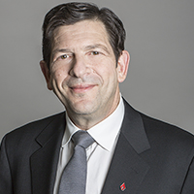
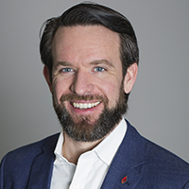
In 2016 the Merinoff & Wirtz families came together to form Breakthru Beverage Group
3rd and 4th generation family leaders are still actively engaged in the business
CHARLIE MERINOFF
Co-Chairman, BBG
DANNY
WIRTZ
Co-Chairman, BBG
3rd Generation Family Owner
Served as Chairman and CEO of Charmer Sunbelt Group before the BBG Merger
Sits on the boards of the Culinary Institute of America, the Thurgood Marshall College Fund, and the Federal Law Enforcement Foundation
4th generation Family Owner
Served as President and CEO of Wirtz Beverage Group before the BBG Merger
Former chairman of WSWA
Sits on Boards of several Chicago-based civic organizations
Chairman and President of Wirtz Corporation

Slide 3









Breakthru Beverage Group’s History
1934-1945
McKesson Wine and Spirits, Blue Crest Wine and Spirits & Wirtz Corporation begin beverage distribution
1946-
1996
Merinoff and Wirtz families expand beverage holdings in
the East, Midwest and Southwest
AK
1997
McKesson & Merinoff Holdings merge to form Charmer Sunbelt Group
1997-2010
Charmer Sunbelt continues to expand U.S. footprint
CANADA
WA
ME
2010
Wirtz-owned distributors consolidated into Wirtz Beverage Group
MT
ND
VT
NH
MN
MN
MN
NY
MA
NY
NY
OR
WI
NY
RI
WI
ID
SD
WI
CT
CT
CT
2014
Wirtz Beverage Group expands into Canada
WY
MI
PA
CT
PA
PA
IA
PA
NJ
MD
MD
MD
MD
NE
OH
MD
DE
DE
DE
NV
IN
DE
NV
NV
IL
IL
UT
IL
WV
VA
MD/DC
VA
2016
Merinoff & Wirtz families come together to form Breakthru Beverage Group
CO
VA
CO
CO
KS
MO
KY
CA
MO
CA
NC
TN
SC
SC
SC
SC
SC
AZ
OK
AR
SC
AZ
AZ
AZ
AZ
HI
AZ
NM
AL
GA
2018
Kindred is established in Canada
MS
TX
LA
2022
Breakthru enters MO through Major Brands acquisition & expands footprint in MN through JJ Taylor acquisition
FL
2023
Breakthru enters CA through Wine Warehouse acquisition

Slide 4
BREAKTHRU BEVERAGE GROUP
AK
CANADA
~$8.5 BILLION
annual revenue
WA
ME
10,000+
associates
TBA
portfolio of premium spirits, wine, beer and non-alc
MT
ND
VT
NH
MN
MN
MN
NY
MA
NY
NY
OR
WI
NY
RI
WI
ID
SD
WI
MI
CT
WY
PA
PA
PA
IA
PA
NJ
MD
NV
NE
IN
OH
MD
DE
NV
NV
IL
IL
UT
IL
WV
VA
MD/DC
VA
CO
VA
CO
CO
KS
MO
KY
CA
MO
CA
NC
16
U.S. markets, and across Canada*
3rd
largest wine & spirits distributor in the United States
4th
generation, family owned and operated
TN
SC
SC
SC
SC
SC
AZ
OK
AR
SC
AZ
AZ
AZ
AZ
HI
AZ
NM
AL
GA
MS
TX
LA
FL
*CDI is a BBG affiliate
4

Slide 5
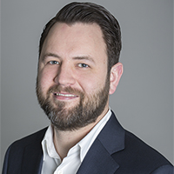
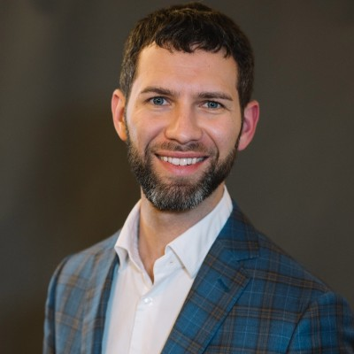
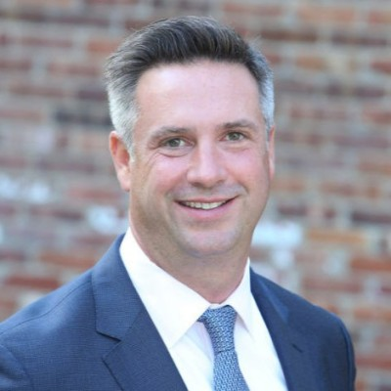
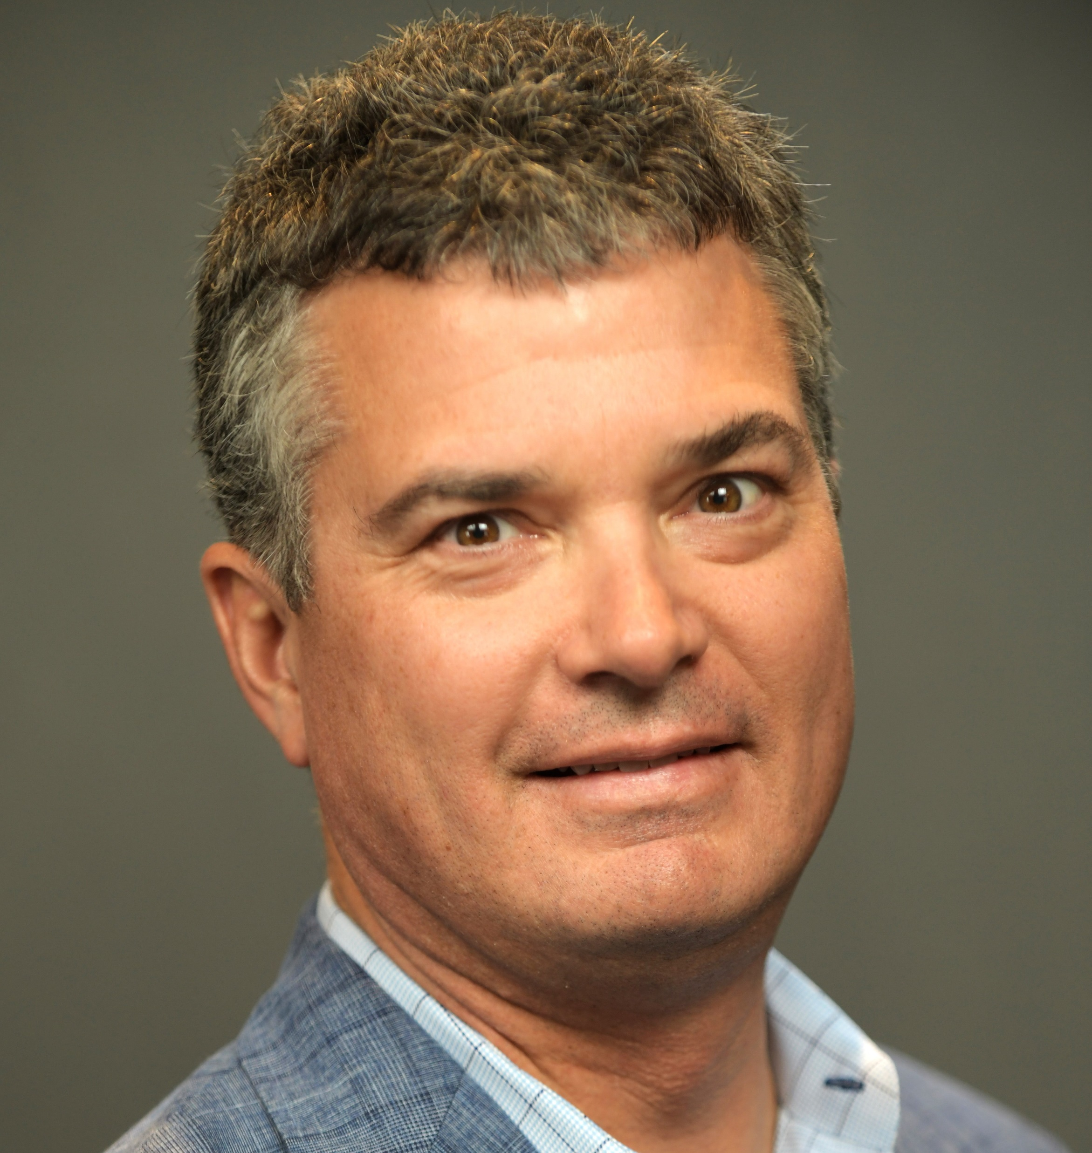
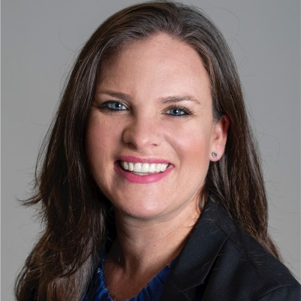
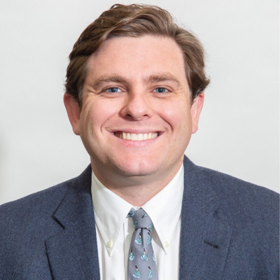
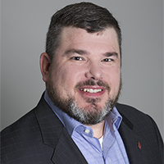
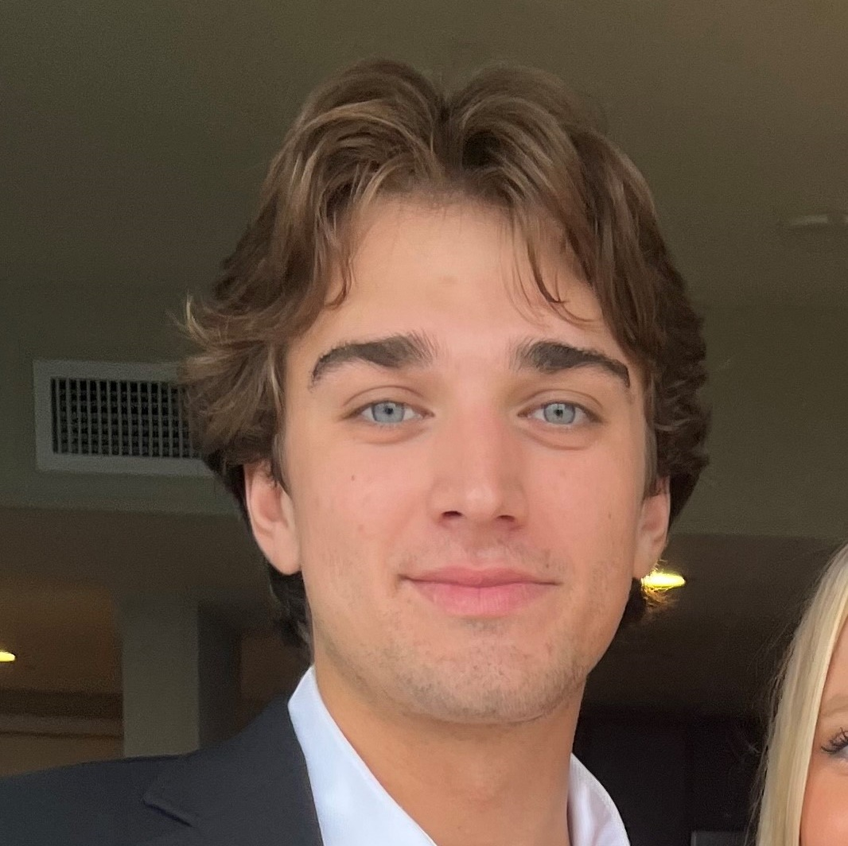
Family ownership operates across all aspects of the business, from the BBG board to in-market sales and merchandising
BRIAN ONUFRYCHUK
Vice President, Board and Shareholder Affairs at BBG
Boards of Directors, BBG and CDI (a BBG affiliate)
JACOB ONUFRYCHUK
Vice President, Corporate Development at BBG
Boards of Directors, BBG and CDI (a BBG affiliate)
CHAD STONE
Vice President, Business Transformation and New Frontiers at BBG
Boards of Directors, BBG, CDI (a BBG affiliate), and Allied Beverage Group
ARTHUR WIRTZ
EVP, Operations at BBG
Board of Directors, BBG
Board of Directors, Wirtz Corp
HILLARY WIRTZ
Sr. Director, Culture & Inclusion
Board of Directors, BBG
Board of Directors, Wirtz Corp
WILLIAM FIX
Manager, Project - Operations
JAMES WIRTZ
Account Development Specialist, BBG
MICHAEL WIRTZ
Merchandiser, BBG
5
5

Slide 6
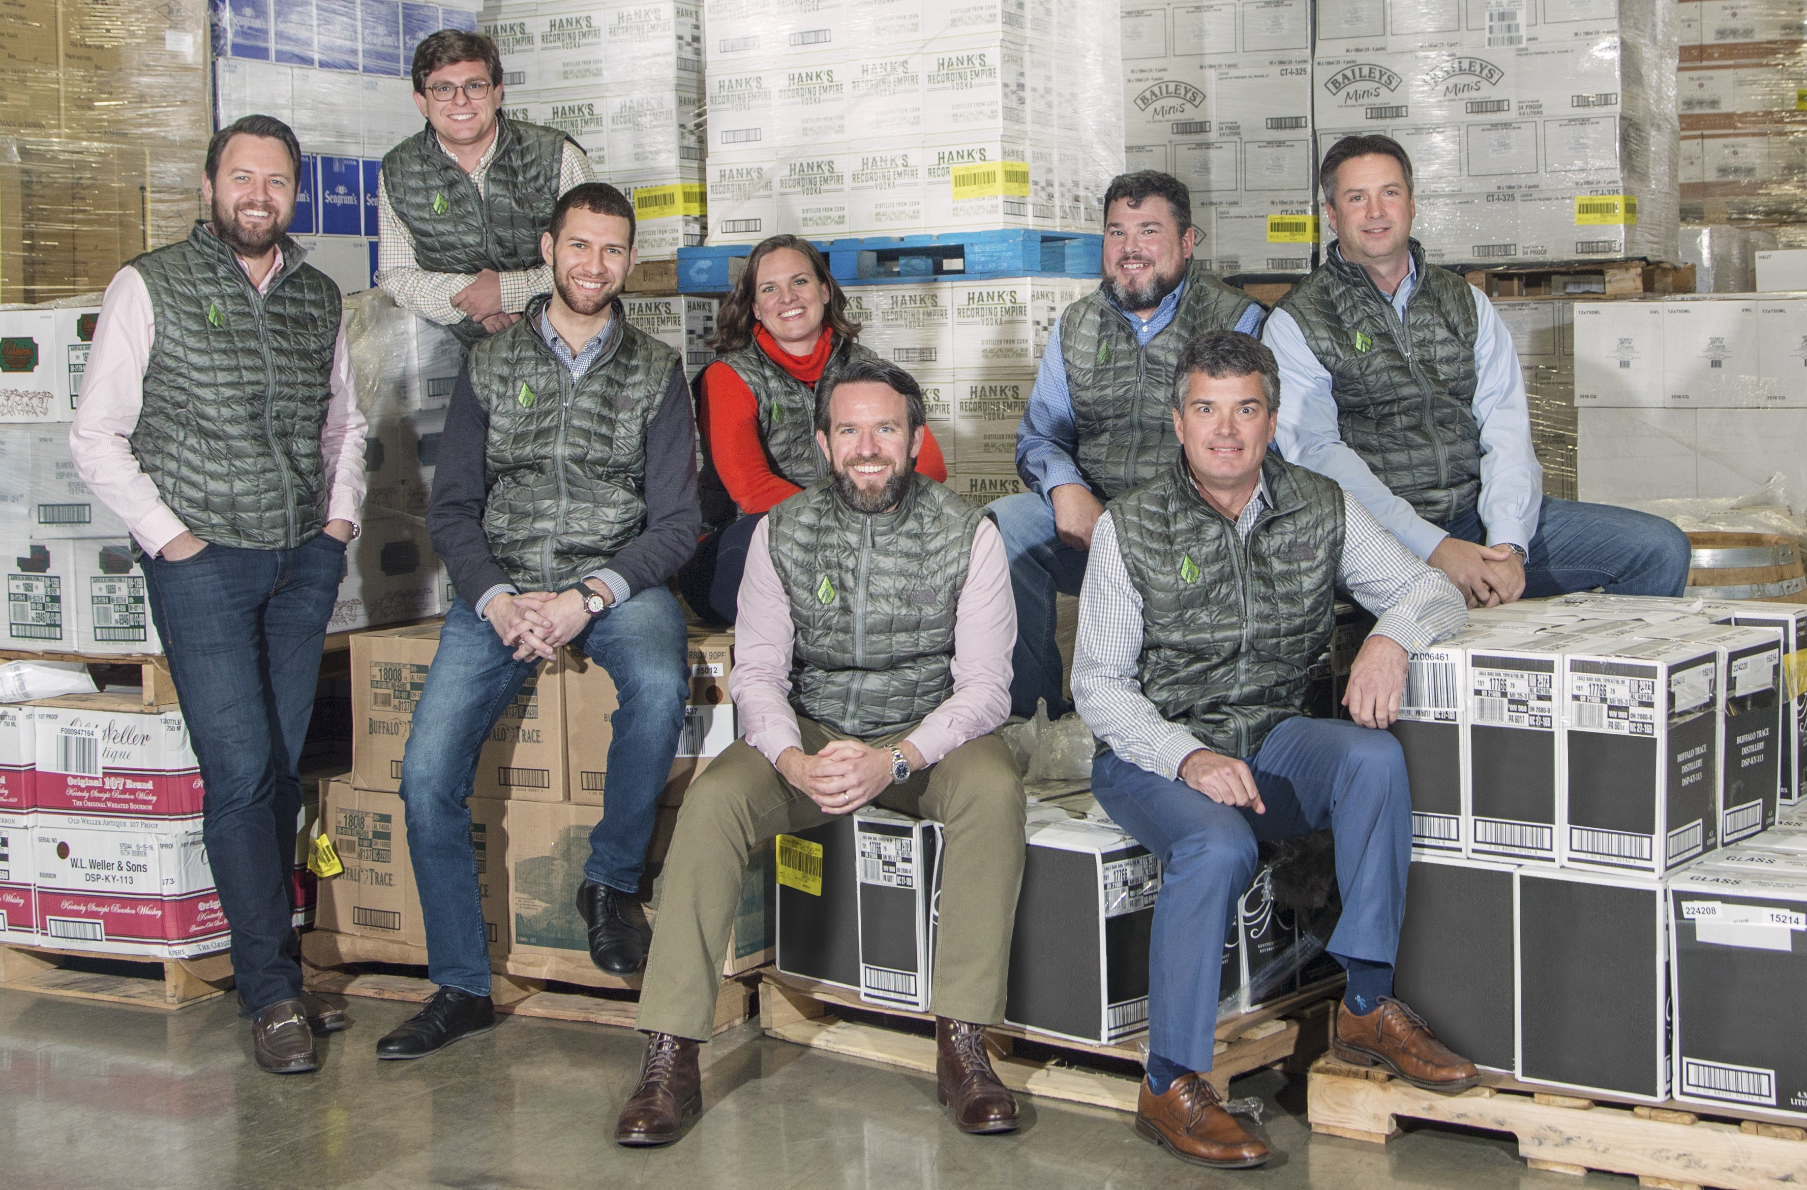
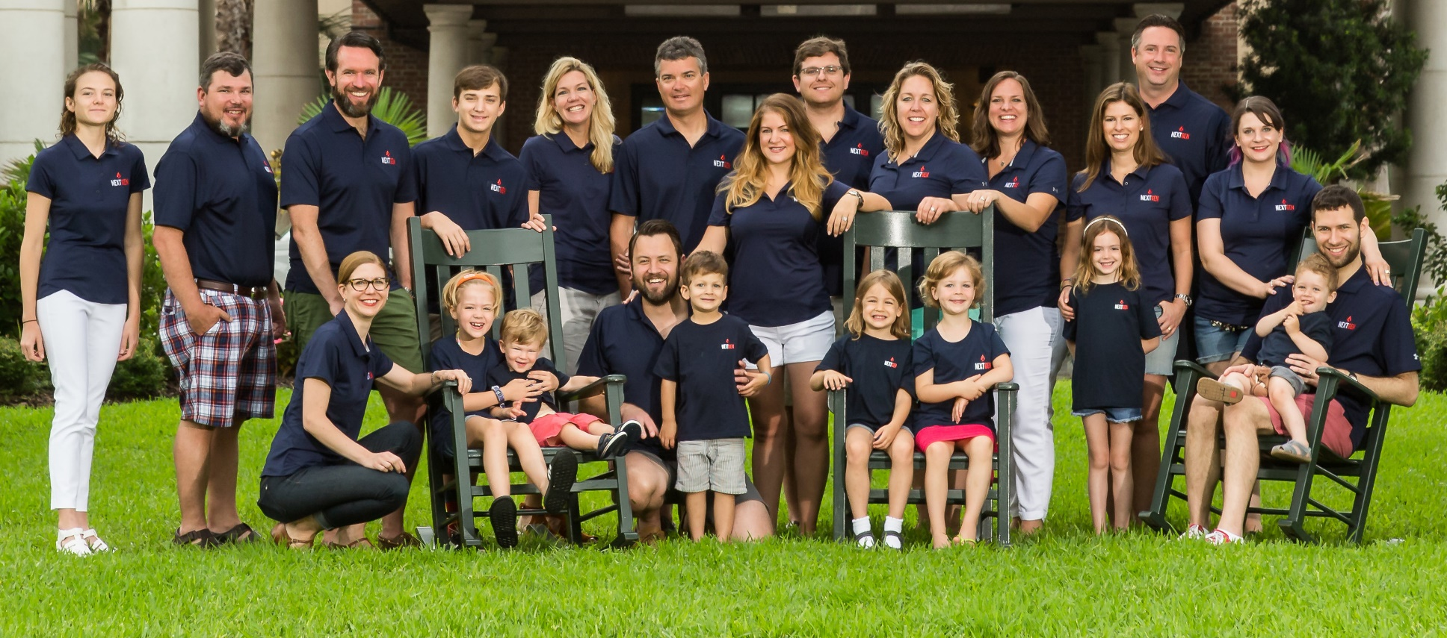
Breakthru NextGen group – Breakthru is and will always be a family-led business
NextGen Mission Statement
We champion the vision of Breakthru Beverage Group by embodying and promoting the values and family culture of our company
Collective Activities and Impact Areas
Building close professional and personal connections
Developing BBG’s CSR strategy in collaboration with a cross-functional management team
Visiting and building supplier relationships with BBG suppliers
“Voice of the family” panel discussions in market and region meetings
Breakthru Next Gen
Next Gen Family Retreat
6
6

Slide 7
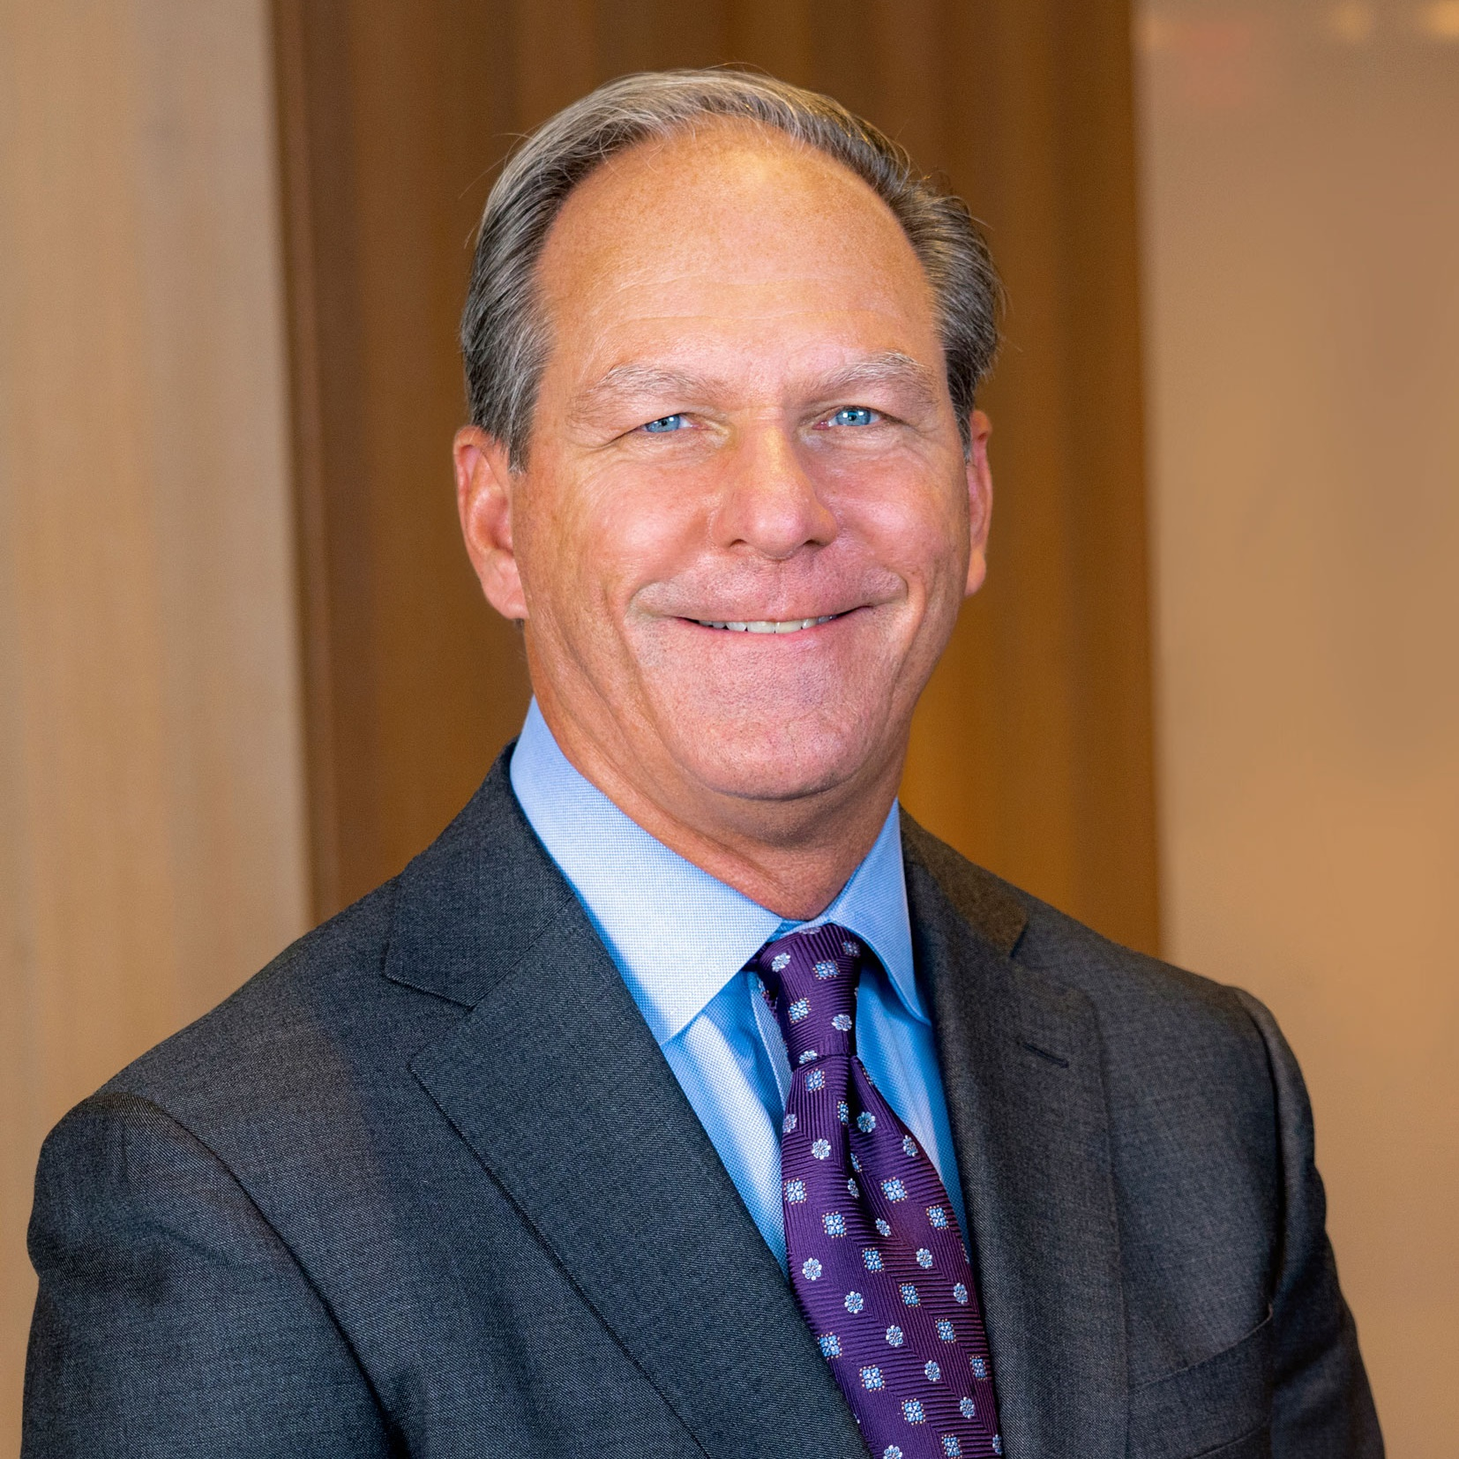



Breakthru’s President & CEO, Tom Bené
Summary
Joined BBG October 4, 2021
Is focused on driving the next phase of Breakthru’s evolution including growth and expansion, accelerating technology and innovation and executing with excellence for supplier and customer partners
Has a proven track record of driving growth and modernizing business models throughout his career
Past Experiences Include:
  National Restaurant Association: President & CEO
  Sysco Corporation: Chairman, President & CEO
  PepsiCo: President, Foodservice
7

Slide 8

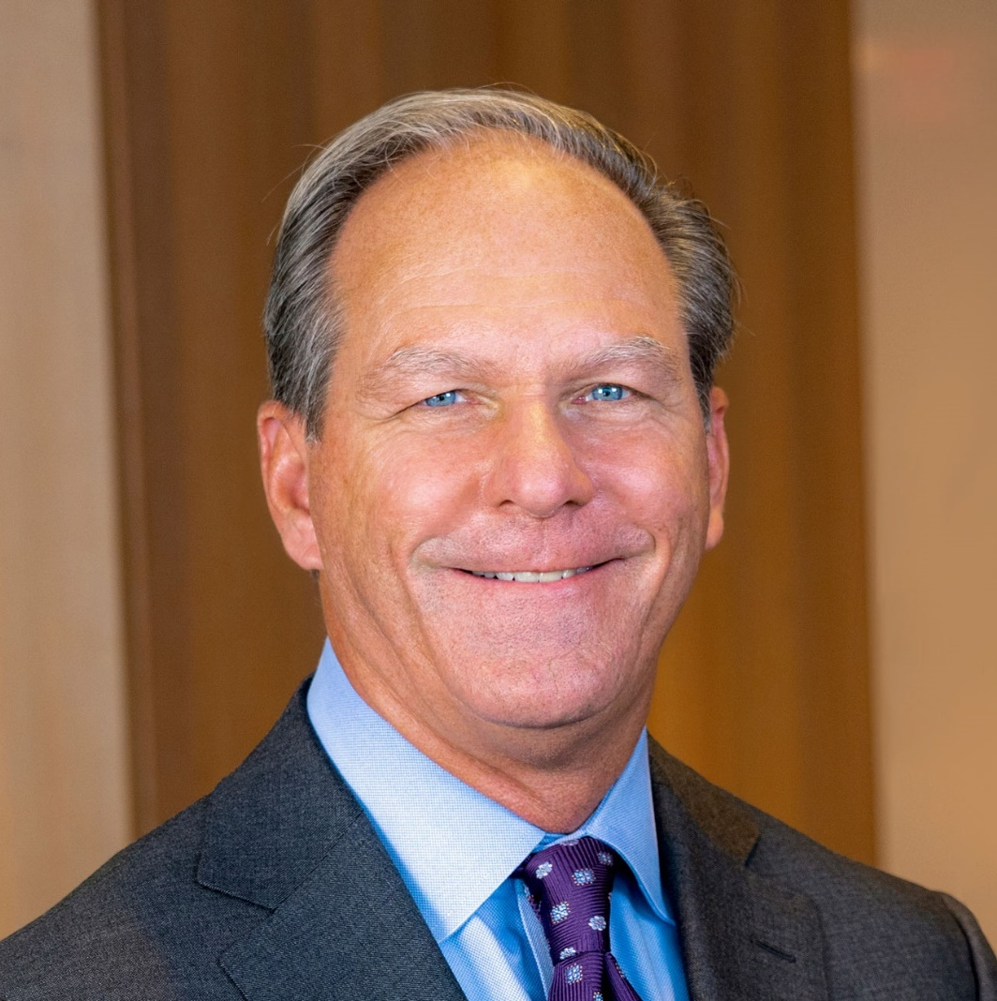
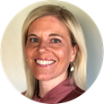
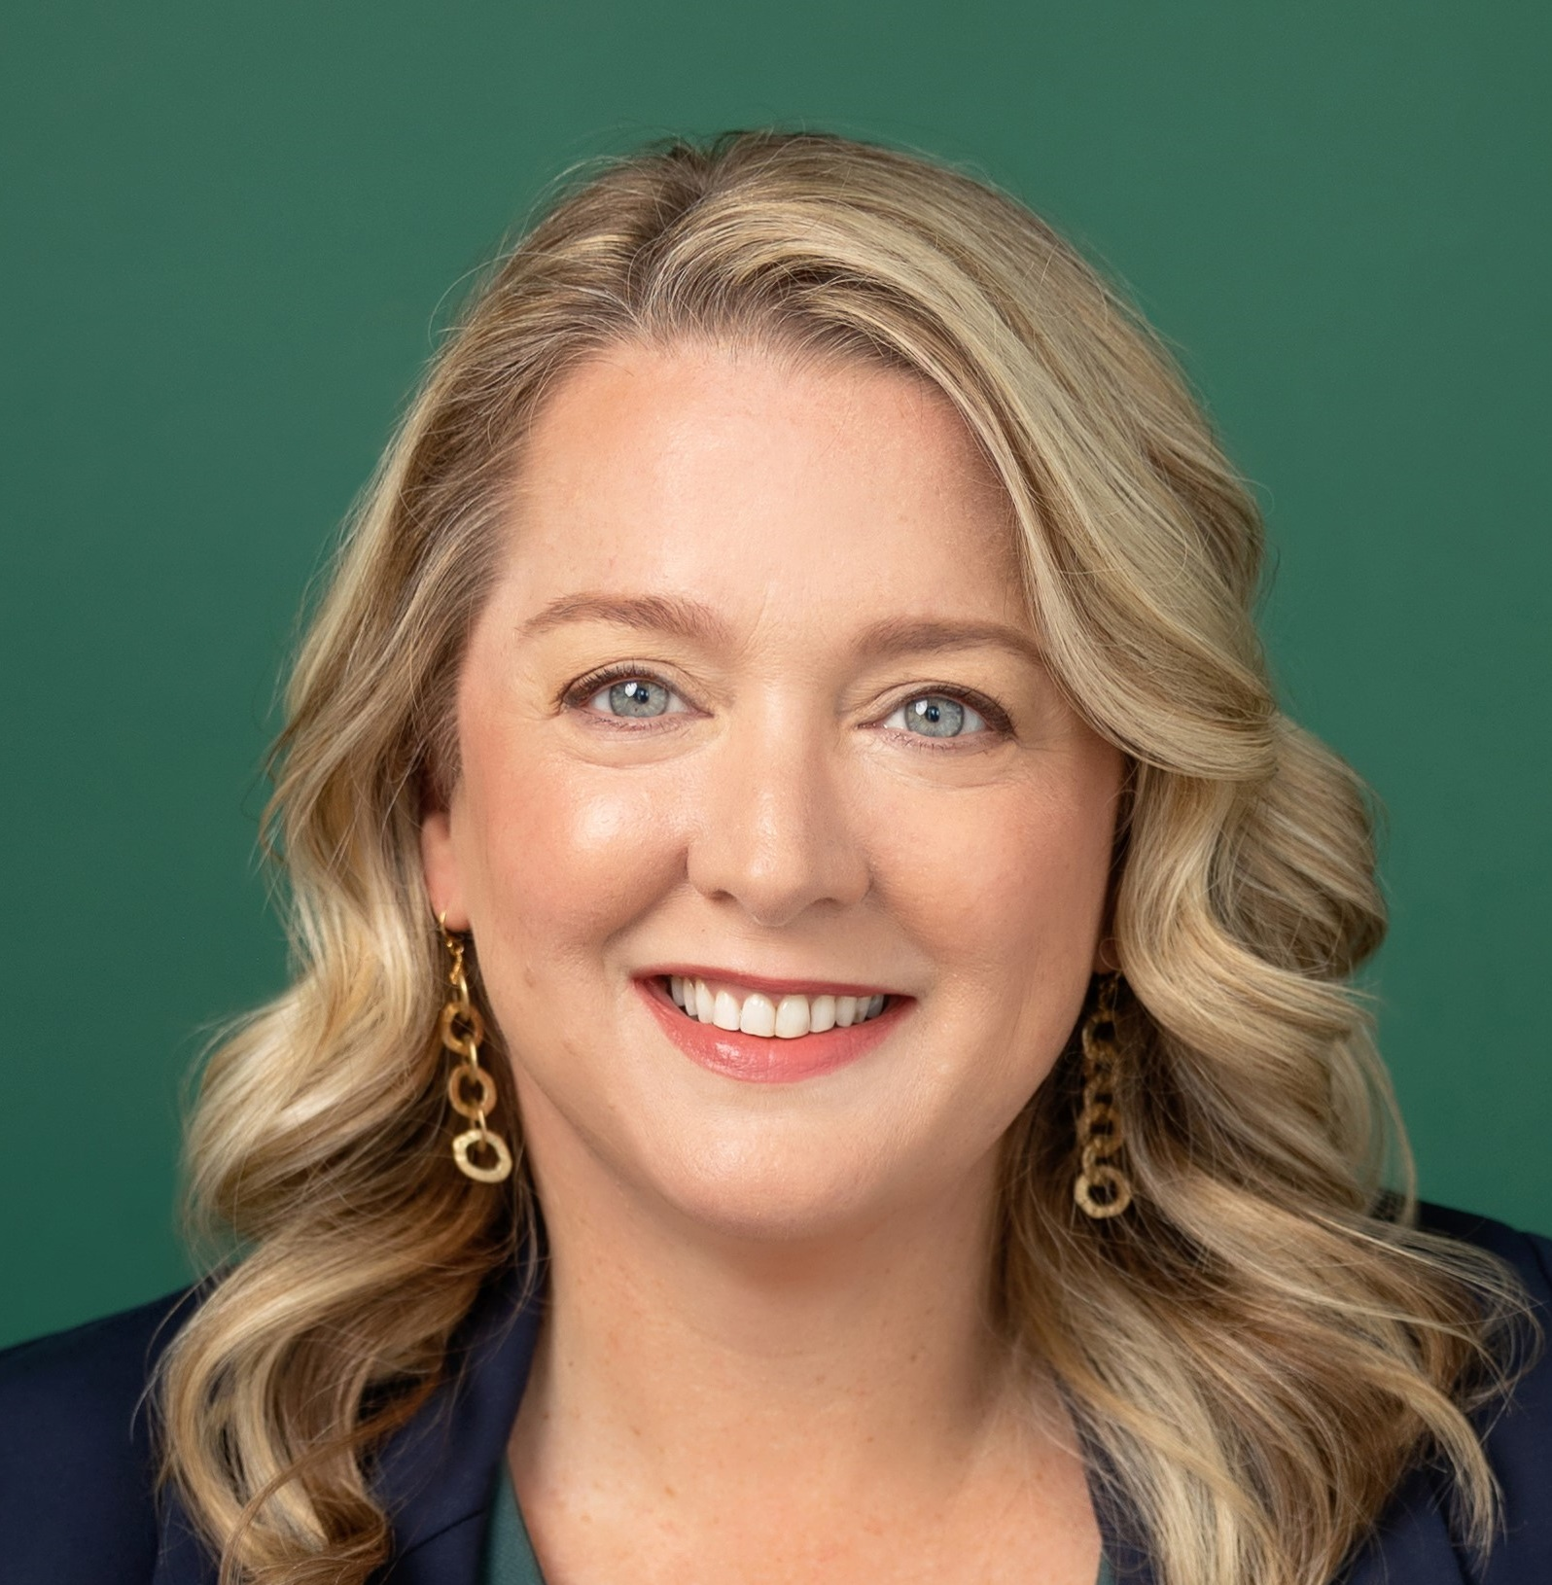
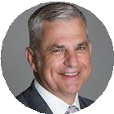
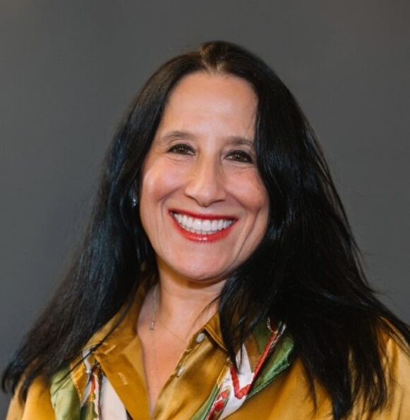

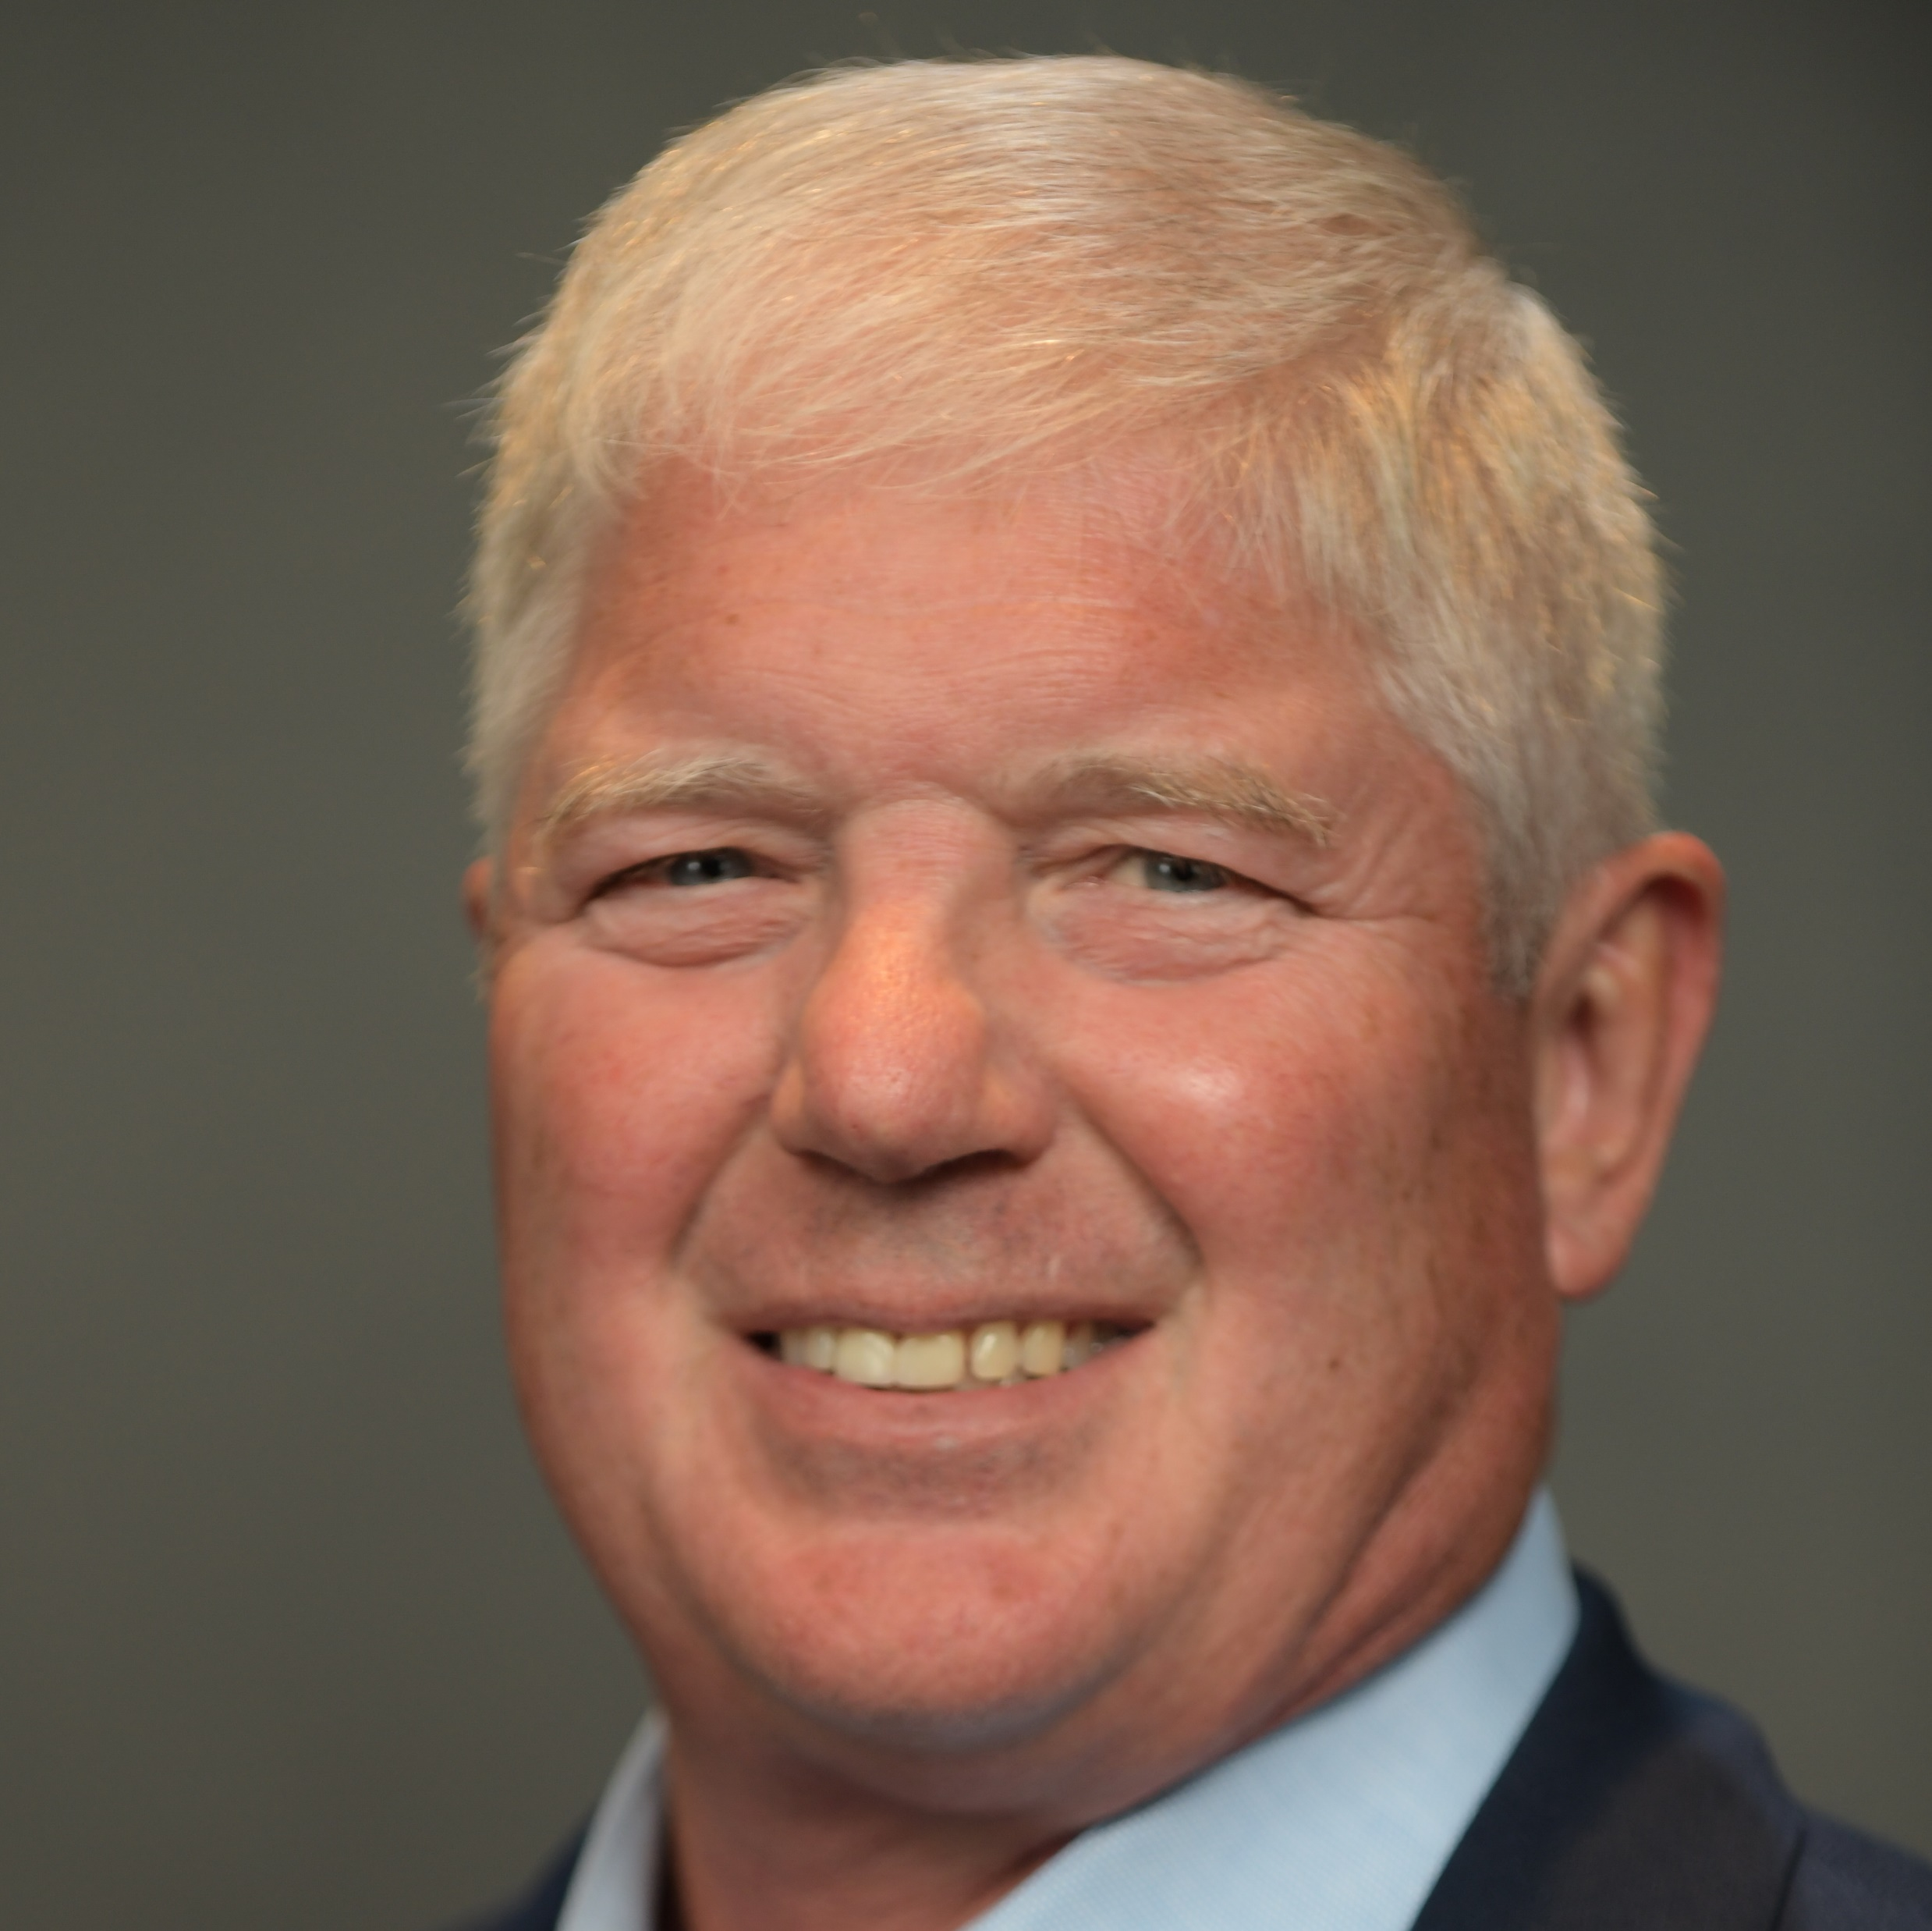
Executive Leadership Team
TOM BENÉ
President and CEO
EXECUTIVE LEADERSHIP TEAM
MELISSA CALDERWOOD
EVP, Chief Financial Officer
STEPHANIE SOTO
EVP, Chief Human Resources Officer
JULIAN BURZYNSKI
EVP, Chief Operating Officer
ARLYN MILLER
EVP, Chief Legal Officer
KEVIN ROBERTS
EVP, Chief Commercial Officer
ART WIRTZ
EVP, Corporate Operations
JOE BRUHIN
EVP, Chief Information Officer
8
8

Slide 9





Framing the culture of the future
Leadership Principles – Definitions
People First
Boldly Seek a Better Way
Customer & Supplier Focused
How we defined it
We believe all exceptional results start with our people. We want to be deliberate and purposeful in their nurture and development so that they feel valued.
How we defined it
Be bold. Think differently about the business and look for opportunities to do things better.
How we defined it
Understand and execute against our suppliers’ consumer strategies while delivering best-in-class performance to our customers.
Listen to Understand
One Team
How we defined it
Listen. Ensure everyone feels heard, resulting in better decisions and outcomes for all.
How we defined it
We are One Breakthru. We strive for individual excellence and know that to achieve our strategic ambition, we must work for the good of the whole. Together we win!
9

Slide 10






We Launched Our Bold People Strategy in FY23
Our People Strategy Vision: To Be the Place Everyone Wants to Work
ATTRACT &
RETAIN
EMPOWER ASSOCIATES
GROW OUR
TALENT
CULTIVATE
A PURPOSE
REWARD PERFORMANCE
UNLEASH TECHNOLOGY
Find and recruit the best talent to fuel our growth strategy and retain them throughout the stages of their career.
Enable associates to use their expertise and passion to solve problems, innovate solutions and drive business results.
Provide associates with tools to achieve peak performance and the opportunity to advance in their career.
Connect associates to a cause larger than themselves, creating a sense of belonging, and a culture of trust and respect.
Design performance management to achieve business strategy. Reward results.
Unleash the power of technologies and leverage them as a seamless enabler of innovation to enhance the associate experience.
Shaped By Guiding Principles
People Focused * Innovative * Flexible * Performance Based * Diverse & Inclusive * Technology Enabled
10

Slide 11


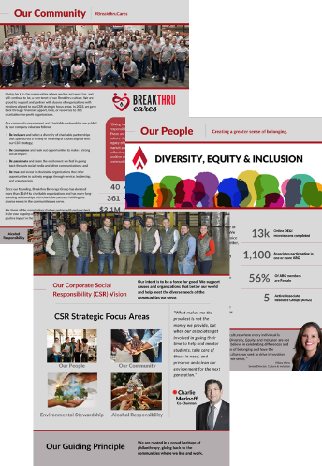
We Launched Our 1st Annual
Corporate Social Responsibility Report
Our first CSR Report: Crafting the Future, Together was released April 10.
The CSR Report represents our collective Breakthru story—strong leadership, force for good, focus on growth, leading beverage company, values-based & people-centric culture, legacy of philanthropy, DE&I advocacy, and differentiated associate experience.
External
    Social media
    BBG website
    Press release
11
Notes:
BBG recently introduced our first-ever Corporate Social Responsibility (CSR) Report: Crafting the Future, Together.
The CSR Report represents our collective Breakthru story—strong leadership, force for good, focus on growth, leading beverage company, values-based & people-centric culture, legacy of philanthropy, DE&I advocacy, and differentiated associate experience.
It’s exciting to share our story more broadly with our customers, suppliers, associates, and community as to the outstanding success that we’re making toward becoming the top-performing distributor in every market we serve and the place everyone wants to work. In 2023, we supported 361 charitable causes, participated in 40 volunteer events, and invested over $2.1 million in non-profit organizations.
You can engage with the CSR Report by (click on the provided links):
Reviewing the report and press release.
Sharing, liking, and commenting on the social media post.
Taking the opportunity to share the report with customers/suppliers (the Commercial organization will receive a ‘customer leave-behind’) and prospective candidates.
In the year ahead, we’re doubling down on leading with a people-first approach, enhancing our focus on the customer and associate engagement, maximizing growth for our supplier partners, and caring for our communities. We remain wholeheartedly committed to exploring and implementing innovative changes to build an even better, stronger Breakthru. While doing so, we’ll continue to be a force for good.
Together, we’re crafting a more sustainable, inspiring, and equitable future!

Slide 12

The colorful rainbow target represents the vibrant nature of our culture and diversity of our people. The Breakthru Spear aims courageously at the center which represents our individual and shared success.
The three pillars of the Breakthru Experience are Growth, Belonging and Wellness.
12
Notes:
STEPHANIE

Slide 13

Introducing the AVP statement and 3 pillars: Growth, Belonging and Wellness
We are committed to being the place everyone wants to work, fostering an environment where you feel like family, you enjoy and are proud of your work, and success is celebrated. We provide the opportunity for you to reach your full potential, thrive in a collaborative & inclusive culture, and be supported in living well.
GROWTH
BELONGING
WELLNESS
Breakthru provides learning, development, and career opportunity.
Breakthru has a celebratory, inclusive, and family-like culture.
Breakthru offers support and benefits
to live well.
Industry-leading Training (e.g., WSET)
On-demand Learning Platform (The Learning Bar)
Sales Enablement Training & Industry-leading Certifications
Various Development Session Offerings
Leadership Principles & Development Programs
Early Career Opportunities
Scholarship Programs
Education Assistance Program
Mentorship Program
Job Opportunities Promoted Internally
Family-owned
Strong Company Values
Associate Resource Groups (ARGs)
Diversity Events/Celebrations
Culture Ambassadors
Community Volunteering Opportunities
Proud Heritage of Philanthropy
Associate Recognition & Appreciation Programs
Environmentally Sustainable Efforts (ESG)
Employee Referral Program
Hybrid & Flexible Work*
Competitive and Comprehensive Total Rewards (Bonus Plans, Sales Commissions/Incentives, Medical, Dental, Vision, HSA & FSA, Pet Insurance)*
Paid Time Off + Holidays
Employee Assistance Program (ComPsych)
Wellness Platform (Pulse)
Early Wage Access (Payflex)
Parental Leave & Adoption Assistance
Retirement Savings (401K)
Discount Program (Work Perks)
13

Slide 14



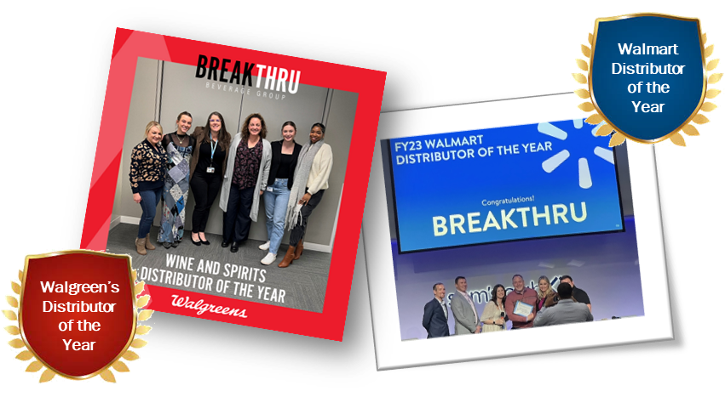

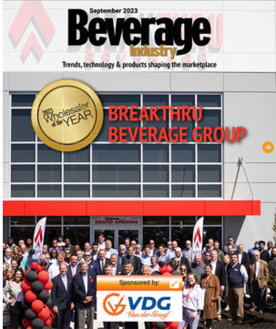
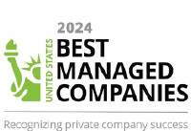
We’ve Built Incredible Momentum Over the Past Few Years, Enabling Us to LEAD GROWTH
MO
MN
Acquisition of Major Brands
in Missouri
Acquisition of JJ Taylor
In Minnesota
CA
Acquisition of Wine Warehouse
in California
14

Slide 15





Vision: To be the leading beverage company in North America
Mission: Build value for our suppliers, customers, associates and communities
STRATEGIC PILLARS
STAKEHOLDERS
SUPPLIERS
Building the value of brands
CUSTOMERS
Driving superior trade performance
ASSOCIATES
Be the employer of choice in beverage
COMMUNITY
Ensure a force of good in all our communities
SHAREHOLDERS
Deliver strong performance and fiscal stewardship
GROWTH
We will pursue opportunities to grow our
business
INNOVATION
We will move with pace to enable new digital capabilities and business models
GROWTH
INNOVATION
PRODUCTIVITY
PRODUCTIVITY
We are focused on performance and profitability
TALENT
TALENT
We will invest in the diversity and expertise of our people
Values:
Be Courageous.
Be Inclusive.
Be Passionate.
Be True.
15

Slide 16
Evolving With The Market
Consumer driving demand for new ways of working across industry
TRADITIONAL PERSPECTIVE
CURRENT PERSPECTIVE
FUTURE PERSPECTIVE
DISTRIBUTOR TIER
SUPPLIER TIER
SUPPLIER TIER
DISTRIBUTOR TIER
DISTRIBUTOR TIER
RETAIL TIER
RETAIL TIER
CONSUMER
SUPPLIER TIER
RETAIL TIER
CONSUMER
CONSUMER
Breakthru will not stand still – shifts in consumer behavior require new capabilities, increased scale, and agility
BREAKTHRU BEVERAGE GROUP
16

Slide 17










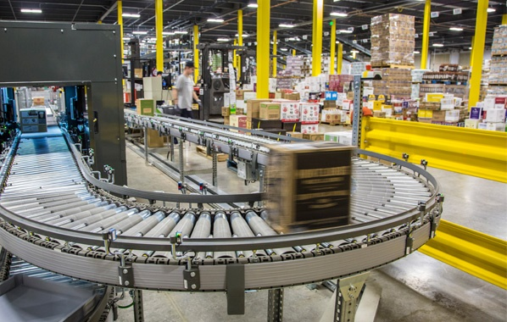



The Annual Company Objectives Tie to the Longer-Term Strategy
GROW THE CORE – OPTIMIZE CURRENT BUSINESS
2024 COMPANY OBJECTIVES
Portfolio Strategy
Digital Evolution
Revenue Management
Optimizing Fulfillment
GROW
ASSOCIATE ENGAGEMENT
DELIVER
OUR
FINANCIAL PLAN
EXECUTE
ROUTE TO MARKET
Efficient Organization
Route-to- Consumer
People Strategy –
The Place Everyone Wants to Work
MERGERS & ACQUISITIONS –
GEOGRAPHIC EXPANSION
IMPROVE OPERATIONAL EXCELLENCE
DELIGHT OUR CUSTOMERS & SUPPLIERS
NEW FRONTIERS –
GROWTH OPPORTUNITIES
17

Slide 18
Leveraging the Customer First Model to Win
Customers and Suppliers
Accelerate growth by removing barriers / obstacles
Providing clarity / speed of decision making
Enable more consistent execution of strategic plans / initiatives
Ensure the voice of the customer / supplier is always in the room
Reinforce the importance of two-way communication
Operates the Business
Execute Plans
Flawlessly
Markets
Enable the
Markets
Provide Resource & Support
Commercial
Team / Regions
Sets Strategic Direction /
Create Tools & Processes
Corporate
18

Slide 19



Evolving our value proposition in support of growth
Top Performing Distributor
A consistent yet scalable market structure that drives effectiveness, a culture of compliance, and makes us easier to do business with
A consumer-backed approach to how we go to market and win across customer channels
A digitally enabled sales force empowered to focus most their time on consultative selling, armed with precision insights on shoppers and highest ROI activities
A full suite of forecasting and inventory management tools to ensure we meet customer needs as efficiently as possible, increase speed-to-shelf of new products, dramatically reduce out-of-stocks, and improve data visibility and insights to suppliers
A foundation for advanced pricing analytics and spend analytics to better inform optimal price points & future pricing investments
19

Slide 20






Commercial Business is supported Operations, Supply Chains and Logistics expertise
Breakthru’s Operational
Infrastructure
Breakthru is committed to driving
continuous improvement
59
Office and
warehouse facilities
7.9 million
Square feet of warehouse
We are investing in state-of-the-art facilities in Florida
We are advancing demand planning to improve service levels and inventory management
Deliver consistent, high-quality supply chain and operational execution that outperforms the competition
1,322
Trucks in our fleet
15,000
Deliveries per day
>
151,000
Average bottles picked per night
93 million
Cases delivered per year
20

